Slide 1
2nd International Seminar of Sustainable Public Procurement
How to develop strategies to introduce Sustainable Procurement Policies in Governmental Institutions
Barbara Morton
Director, Sustainable Procurement Ltd
Brasilia, Brazil
27 August 2014

Slide 2
Outline
Introductions
Background - international activity, Marrakech approach
Defining sustainable procurement
Strategies to introduce sustainable procurement policies
Examples of laws and policies
Delivering sustainable outcomes and tracking progress

Slide 3
Who we are
Sustainable Procurement Ltd
  Manchester & Hampshire in England and Perthshire, Scotland
Specialists in training and consultancy
  Technical Advisor to the Marrakech Task Force on SPP
  Project Manager - UK Sustainable Procurement Task Force
Clients: over 40 countries in 10 years
  ITAIPU BINACIONAL – Brazil/Paraguay
  African Development Bank
  Chile - through British Embassy in Santiago
  Swiss-Ghana Project with Ghana Public Procurement Agency
  The Scottish Government

Slide 4
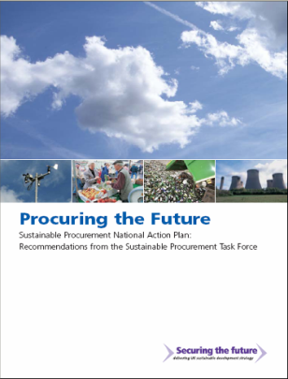
What is Sustainable Procurement?
        “Sustainable Procurement is
        a process whereby organisations meet their needs for goods, services, works and utilities in a way that achieves value for money on a whole life basis in terms of generating benefits not only to the organisation, but also to society and the economy, whilst minimising damage to the environment”.
Procuring the Future – June 2006

Slide 5
What is Sustainable Procurement?
“Sustainable Procurement should consider the environmental, social and economic consequences of:
    Design;
    non-renewable material use;
    manufacture and production methods;
    logistics;
    service delivery;
    use; operation; maintenance;
    reuse; recycling options; disposal;
... and suppliers' capabilities to address these consequences throughout the supply chain.”

Slide 6


The Marrakech Task Force on
Sustainable Public Procurement
UN process on Sustainable Consumption and Production
Supported and led by the Swiss Government (Swiss Federal Office for the Environment) Started in 2005
Participants included
  Switzerland, USA, UK, Norway, Philippines, Argentina, Ghana, Mexico, China, Czech Republic, State of Sao Paolo (Brazil)
  ICLEI, UNEP, IISD, International Labor Organization (ILO), European Commission (DG-Environment)
Piloted in:
  Chile, Colombia, Costa Rica, Mauritius, Mexico, Tunisia, Uruguay
Training of Trainers 2011 – to build capacity worldwide
New programme led by UNEP

Slide 7
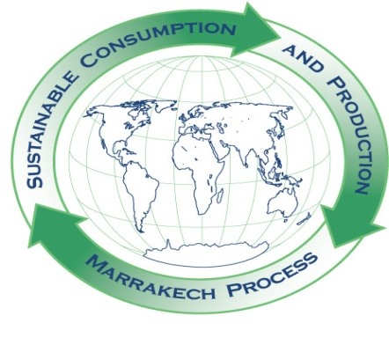
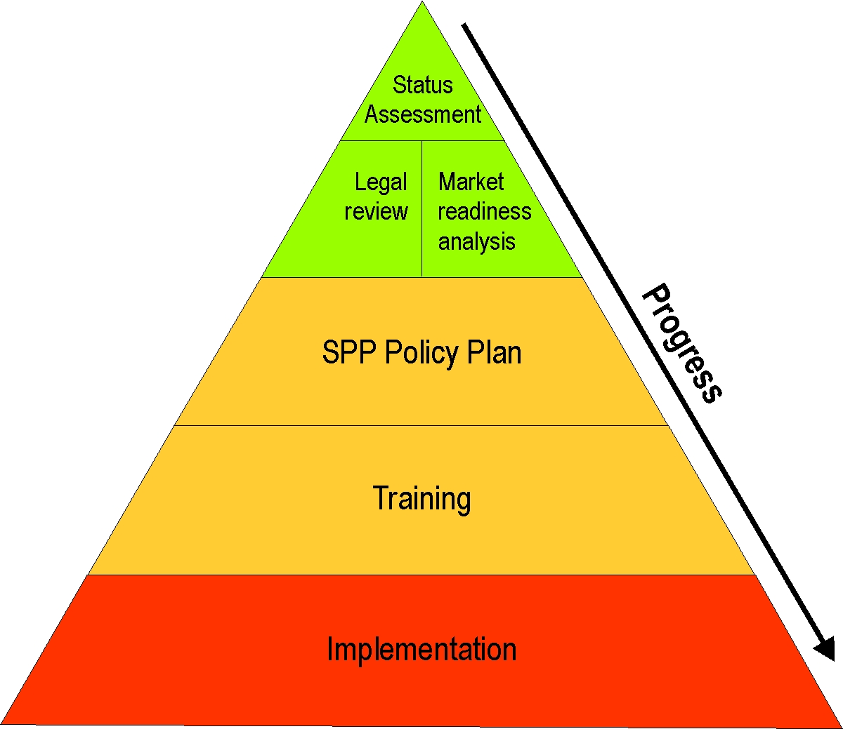
MTF on SPP Approach
Country Implementation

Slide 8
Why have a policy on SPP?
Provides clarity on objectives
Provides legitimacy for procurement actions
  Reducing emissions, reducing waste, increasing recycled content, concern for working conditions, etc
Provides transparency for stakeholders, including:
  Heads of department, budget-holders, users
  Suppliers and contractors
Provides an ‘audit trail’ for procurement actions
The ‘hook’ on which all SPP actions depend

Slide 9

Keys to a good policy
Short!
Statement of intent & high level commitment
Signed off at high level to demonstrate ownership
Specific to its context:
  National, institutional, departmental, etc
  To demonstrate relevance and proportionality
Reviewed on a regular basis
  Feedback from stakeholders should inform review

Slide 10
What it is and what it is not
SPP Policy describes sustainable outcomes to be delivered through public procurement
Policy is not a Strategy
  Strategies set out details & specifics of HOW the policy will be delivered
Policy is not an Action Plan
  Action Plans show WHO will do WHAT, by WHEN

Slide 11
Stakeholder Engagement
In development of SP policy, strategy and action plans
Executive / Elected members
Internal customers / Users of service
Finance
Legal
Specifiers
Suppliers and contractors
Technical specialists
Non-governmental organisations
Public
Media
Others?
How can lessons learned be reflected in Policy and Strategy in your organisation?
Does your Policy and Strategy adequately support SP aims and enable benefits to be realised?
Engage relevant stakeholders early …

Slide 12
SPP and Life cycle costing
Value for Money on a Whole Life Basis
The higher initial price of the greener product is more than compensated by the much lower usage
and disposal costs.

Slide 13

Examples
Chile
  ChileCompra
  Environmentally Responsible Public Procurement Policy & low carbon economy
Mauritius – MTF/UNEP pilot
Ghana
  Public Procurement Agency
Scotland
  Procurement Reform (Scotland) Act 2014

Slide 14
Example: Ghana
Swiss-Ghana SPP and Monitoring & Evaluation project
Supported by the Swiss State Secretariat for Economic Cooperation (SECO)
SPP Policy being finalised in 2014
Ghana Task Force closely involved
  Ministries of Finance and Environment
  Public bodies e.g. Energy Commission
  Professional bodies – engineers, surveyors
Key policy priorities agreed – transparency, wealth creation, environmental protection
Delivered through public procurement

Slide 15
Example: Ghana - SPP Policy Framework
Implemented through:
Sector specific laws aimed at addressing environmental, economic or social issues - enforcement remains a challenge
Particularly in the case of oil, gas & other extractive industries
      To tackle issues of environmental degradation
      Pollution
      Local content & labour issues
      Development of deprived communities
Need Public Purchasing Decisions to enhance or supplement enforcement of sector specific laws.
[Extract from Swiss-Ghana Project – Training of Trainers Course July 2014]

Slide 16
Example: Ghana Policy Statement (draft 2014)
The purpose of this policy is to guide the Public Procurement Authority (PPA) and all public institutions in:
  Minimising the negative environmental and socio-economic impacts of production and consumption in Ghana
  Maximising the opportunity arising from sustainable consumption and production
  Reducing the generation of waste through increasing economically viable opportunities for recycling and reuse
  Triggering markets for environmentally, socially and economically sustainable goods, services and works
  Embedding whole life value approach into procurement policy strategy and decision-making
  Enhance local content development, gender equity and social inclusion in procurement process
  Building capacity of procurement practitioners and suppliers/contractors

Slide 17

Example: Scotland’s Approach
Scottish Model of Procurement
Improving supplier access to public contracts
Delivering savings and benefits
Embedding sustainability in all we do
Maximising efficiency & collaboration
Public procurement in Scotland
= £9+ billion per annum
Quality
Cost
Sustainability

Slide 18


Sustainability: at the heart of all we do
The Scottish Government
Marrakesh approach
300 public procurement professionals trained
Community benefits
Environmentally conscious
renewable power generation
sell green electricity back to the grid
Electricity
Commonwealth Games 2014
351 Jobs, 113 Apprentices
Glasgow Housing Association 577 Apprentices, 482 Trainees
energy efficiency measures
Socially responsible
3500 Training opportunities
Supported businesses
Article 19 National Framework
11 suppliers, up to £5m a year

Slide 19
Content of the Bill as introduced to Parliament
Background - Procurement Reform (Scotland) Bill
Duties | Proposed Measures
Treat relevant economic operators equally and without discrimination and act in a transparent and proportionate manner Comply with the sustainable procurement duty | 1. Publish Procurement strategy and report against it annually
 | 2. Publish Contracts Register
 | 3. Consider Community Benefits – for all major contracts
 | 4. Regulations about the use of technical specs
 | 5. Prohibit charging for participation in procurement process
 | 6. Use a standard and proportionate pre qualification questionnaire
 | 7. Publish advert and award notices
 | 8. Exclusion of bidders
 | 9. Climate Change (Scotland) Act 2009 – amendment re recycled and recyclable products
 | 10. Debriefing of unsuccessful bidders
REMEDIES
Notes:
10 min
So, if we are looking at the content of the Bill as introduced to Parliament on the 3rd of October it consists of the handful of duties and measures
The 2 general duties are all aimed at promoting good practice – things we should already be doing, they are designed to shift perception from assuming procurement is about lowest price when it should actually be about better value.
We must not forget that the Bill is about making it simpler to do business with the public sector, and simpler for the public sector to spend money wisely.
In terms of the duties
We must treat relevant economic operators equally and without discrimination and act in a transparent and proportionate manner
The sustainable procurement duty means… before carrying out a procurement we must consider how in conducting the procurement process a contracting authority can
Improve the economic, social, and environmental wellbeing of authority’s area
Facilitate the involvement of small and medium enterprises, third sector bodies and supported business in the process
Promote innovation
and in carrying out the procurement act with a view to secure such improvements.
Before I continue in terms of scope it is worth being aware that
We are not proposing that the Bill applies to all contracting authorities
And we are proposing that a “regulated procurement” means “goods and services” procurements from £50k to the EU Threshold and for “works” procurements from £2m to the EU Threshold.
In terms of the specific measures – the Bill proposes that
1. Contracting authorities publish their corporate procurement strategy and report against it annually – we are proposing that the strategy would include the contracting authorities approach to prompt payment, and only applies to public bodies with a procurement spend of over £5m per annum.
2. The Bill proposes that Public bodies maintain and publish a Contracts Register for regulated procurement – this could be on their website
3. As part of the procurement process contracting authorities are to consider Community Benefits – for all major contracts (which are all contracts over £4m) – Here Public bodies will be required to explain why they believe contracts that do not contain Community Benefits should be exempt from their use. It is also proposed that when a contract is awarded, it will have to be stated what Community Benefits clauses are proposed to be achieved.
4. Technical specifications are not allowed to name specific brands. This is already in EU rules. The Bill can give us power to make Regulations regarding the specifics of this. E.g. small lots provision – 20% value
5. Charging for participation in the procurement process is prohibited
6. Contracting authorities are required to use a standard and proportionate pre qualification questionnaire for all regulated procurements
7. Contracting authorities are to publish advert and award notices
8. The grounds for exclusion of bidders is extended to regulated procurements e.g. criminality, black listing
9. The Bill proposes that the Climate Change Act is amended to include the use of re recycled and recyclable products
10. And, last nut not least a requirement for good debriefing of unsuccessful bidders covering regulated procurements
Remedies
The bill also proposes that remedies are proportionate, a light touch approach with actionable duties, procedure and time limits and that these are determined by the court

Slide 20
Procurement Reform (Scotland) Act 2014 process
Steering Group established
To consider social and environmental issues
Representatives of a wide range of stakeholders:
  Scottish Trades Union Congress
  Scottish Fair Trade Forum
  Supplier Development Programme & Social Firms
  Legal experts
  Academia
  As well as Scottish Government Procurement Policy leads
  Secretariat provided by Zero Waste Scotland / WRAP

Slide 21
Procurement Reform (Scotland) Act 2014
Where organisations are obligated:
the need for organisations to have a Corporate Procurement Strategy
and
to be able to demonstrate compliance with relevant legal requirements
The link from National Outcomes and Indicators to relevant organisational procurement objectives

Slide 22
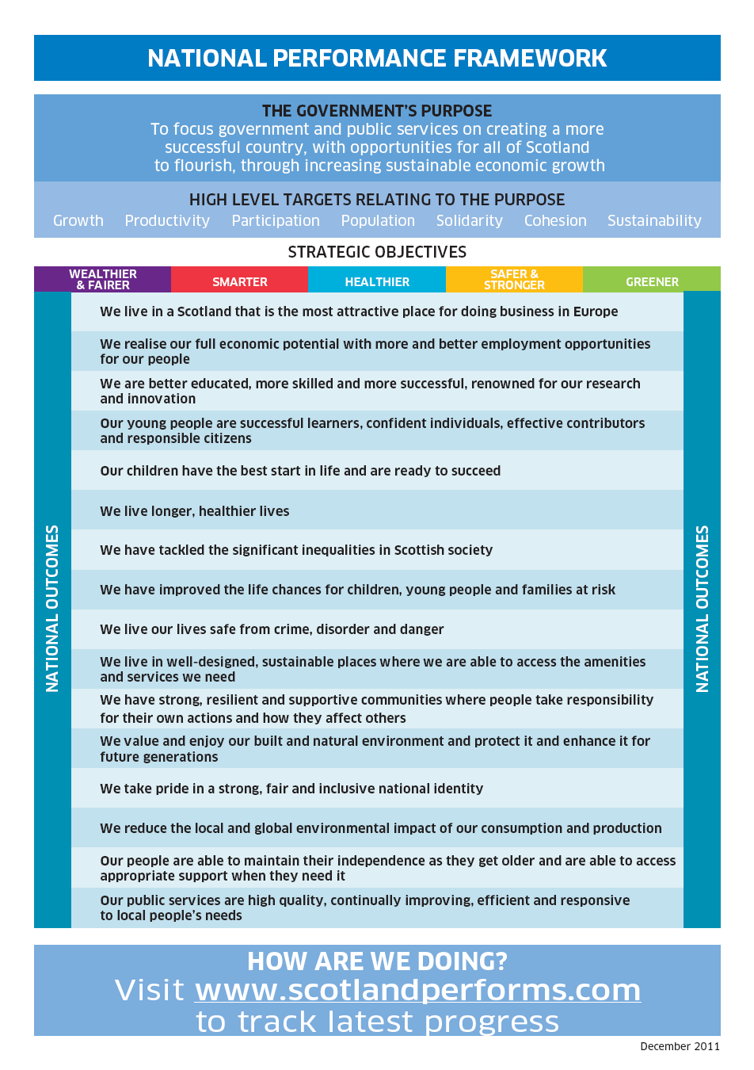
National
Outcomes
Link to Single Outcome Agreements /
Organisational Objectives
Links to reporting requirements of all
public sector bodies in Scotland
Notes:
Our public services are high quality, continually improving, efficient and responsive to local people's needs
We live in a Scotland that is the most attractive place for doing business in Europe
We realise our full economic potential with more and better employment opportunities for our people
We are better educated, more skilled and more successful, renowned for our research and innovation
We have tackled the significant inequalities in Scottish society
We live in well-designed, sustainable places where we are able to access the amenities and services we need
We have strong, resilient and supportive communities where people take responsibility for their own actions and how they affect others
We value and enjoy our built and natural environment and protect it and enhance it for future generations
We reduce the local and global environmental impact of our consumption and production

Slide 23
Scottish Government Priorities – May 2013 Reflected by the National Indicators
‘Organisational Priorities
Policy & Strategy’
(Scottish Government and core agencies and NDPB’s)
Improve levels of educational attainment
Increase exports
Improve people’s perception of their neighbourhood
Improve Scotland’s Reputation
Improve the skill profile of the population
Improve children’s services
Improve the responsiveness of public services
Reduce death on Scottish roads
Reduce Reconviction rates
Increase No of Business
Reduce the proportion of people living in poverty
Improve digital infrastructure
Widen the use of the internet
Increase research and development spending
Improve perceptions of the quality of public services
Increase the number of new homes
Increase the number of graduates in positive destinations
Increase the proportion of young people in learning training or work
Improve access to suitable housing options
Reduce Traffic Congestion
Improve the condition of protected nature sites
Improve mental wellbeing and end of life care
Improve support for people with care needs
Increase the abundance of terrestrial breeding birds (biodiveristy)
Improve the quality of the healthcare experience
Improve the state of Scotland's marine environment
Reduce Scotland’s Carbon footprint
Increase the proportion of journeys to work made by public or active transport
Reduce Waste Generated
Increase renewable energy production

Slide 24
Clackmannanshire Council Priorities – May 2013
‘Organisational Priorities’
Policy & Strategy
Carbon Reduction
Recyclable/ Recycled Goods
Fair & Ethical Trade
Local Sourcing
Innovation
Health Improvement
Equality and Diversity
Accessibility
Waste Reduction
Community Benefits
Energy and Resource Efficiency
A Healthy and Protected Environment
Regeneration, Jobs and Skills
Construction
Cost Savings
Safer Communities
Transport
Climate Change Adaptation

Slide 25
Stakeholder and
Supplier Engagement
Identify need & assess risk
Specification
Supplier Selection
Evaluation and Award
Supplier Management
Contract Management
Good Procurement is Sustainable Procurement

Slide 26
Sustainable Procurement ‘Golden Thread’
International and national laws, policy priorities and commitments
Scotland
Performs
Organisational frameworks, policy priorities, commitments and targets
Tools & techniques:
Prioritisation methodology
Procurement strategies,
action plans and
targets
Corporate Procurement Strategy
Life cycle impact mapping
Projects,
products
services
Product & supplier selection
Notes:
Refer to biomass strategy – keep it in context of the narrative.

Slide 27
The Flexible Framework – a route map
Lead
People
Policy, strategy and communications
Procurement process
Engaging suppliers
Measurement and results
Enhance
Ambition
Practice
Embed
Foundation
Time

Slide 28
Flexible Framework
A maturity matrix
Useful for:
  Establishing baselines
  Understanding what needs to be addressed – policy, process
  Tracking progress
Can be used to:
  Develop action plans (Scotland has developed an enhanced Flexible Framework and is testing now)
  Compare progress and experiences with other organisations
  Drive delivery of sustainable outcomes

Slide 29
Summary
Developing Sustainable Public Procurement Policy
Involve all relevant stakeholders early
Keep it short and specific to its context
Monitor and track progress
Review and update policy
For Scotland ‘public procurement is a strategic enabler’
Public procurement can deliver sustainable outcomes

Slide 30
Thank you for your attention
Barbara Morton
Sustainable Procurement Ltd
+44 (0)7766 023560
barbara@sustainableprocurement.eu.com
www.sustainableprocurement.eu.com

